Slide 1
Consciousness

Slide 2
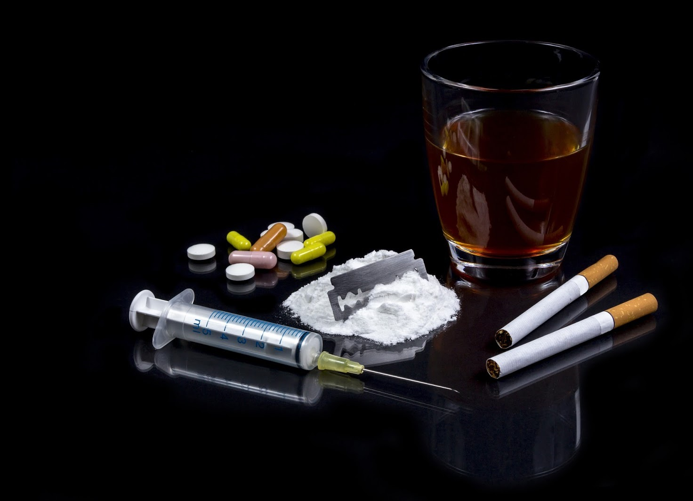
II. PsychoActive Drugs
Psychoactive Drugs
chemical substance that alters perceptions & moods
Addiction - compulsive drug craving & use
Physical dependence physiological need for a drug
- marked by unpleasant withdrawal symptoms
Psychological dependence a psychological need to use a drug
- Ex: relieve negative emotions
Notes:
Psychoactive drugs are chemicals that change perceptions and moods. They may distort peoples’ perceptions, change their moods, or cause them to see or hear things that are not real. A drug’s overall effect depends not only on its biological effects but also on the psychology of the user’s expectations, which vary with social and cultural contexts.
Example: If one culture assumes that a particular drug produces euphoria (or aggression or sexual arousal) and another does not, each culture may find its expectations fulfilled.
Addiction
Why might a person who rarely drinks alcohol get buzzed on one can of beer while a long-term drinker shows few effects until the second six-pack? The answer is tolerance. With continued use of alcohol and some other drugs (marijuana is an exception), the user’s brain chemistry adapts to offset the drug effect (a process called neuroadaptation).To experience the same effect, the user requires larger and larger doses. In chronic alcohol abuse, for example, the person’s brain, heart, and liver suffer damage from the excessive amounts of alcohol being “tolerated.” Ever-increasing doses of most psychoactive drugs can pose a serious threat to health and may lead to addiction: The person craves and uses the substance despite its adverse consequences.
Regular users often try to fight their addiction, but stopping the drug may lead to the undesirable side effects of withdrawal. As the body responds to the drug’s absence, the user may feel physical pain and intense cravings, indicating physical dependence. People can also develop psychological dependence, particularly for stress-relieving drugs, such as alcohol. Although not always physically addictive, such drugs may become an important part of the user’s life, often as a way of relieving negative emotions. For someone who is either physically or psychologically dependent, obtaining and using the drug can become the day’s focus.
Categories of drugs that affect consciousness include depressants, stimulants and hallucinogens.

Slide 3
II. PsychoActive Drugs
1. Stimulants
increase neural activity & speed up body functions
- heart & breathing rates rise
- blood sugar rises - causes drop in appetite
- energy & self-confidence rise
Notes:
A stimulant excites neural activity and speeds up body functions. Pupils dilate, heart and breathing rates increase, and blood sugar levels rise, causing a drop in appetite. Energy and self-confidence also rise.
Stimulants include caffeine, nicotine, the amphetamines, cocaine, methamphetamine (“speed”), and Ecstasy. People use stimulants to feel alert, lose weight, or boost mood or athletic performance. Unfortunately, stimulants can be addictive, as you may know if you are one of the many who use caffeine daily in your coffee, tea, soda, or energy drinks. Cut off from your usual dose, you may crash into fatigue, headaches, irritability, and depression. A mild dose of caffeine typically lasts three or four hours, which—if taken in the evening—may be long enough to impair sleep.

Slide 4
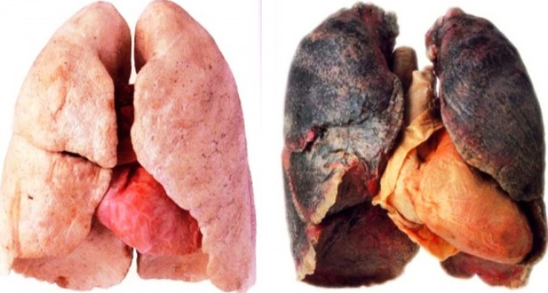
II. PsychoActive Drugs
1. Stimulants
Nicotine
- increases adrenaline & heart rate
- food metabolizes faster
- very addictive
- withdrawal: nervousness, drowsy, insomnia, weight gain
- 10x more likely to die of lung cancer
Notes:
Nicotine: One of the most addictive stimulants is nicotine, found in cigarettes and other tobacco products.
A teen-to-the-grave smoker has a 50 percent chance of dying from the habit, and each year, tobacco kills nearly 5.4 million of its 1.3 billion customers worldwide. By 2030, annual deaths are expected to increase to 8 million. Those addicted to nicotine find it very hard to quit because tobacco products are as powerfully and quickly addictive as heroin and cocaine. Attempts to quit even within the first weeks of smoking often fail. As with other addictions, smokers become dependent, and they develop tolerance. Quitting causes nicotine-withdrawal symptoms, including craving, insomnia, anxiety, irritability, and distractibility. Nicotine deprived smokers trying to focus on a task experience a tripled rate of mind wandering. When not craving a cigarette, they tend to underestimate the power of such cravings.
All it takes to relieve this aversive state is a cigarette—a portable nicotine dispenser. Within 7 seconds, a rush of nicotine signals the central nervous system to release a flood of neurotransmitters. Epinephrine and norepinephrine diminish appetite and boost alertness and mental efficiency. Dopamine and opioids calm anxiety and reduce sensitivity to pain.
These rewards keep people smoking, even among the 8 in 10 smokers who wish they could stop. Each year, fewer than 1 in 7 smokers who want to quit will be able to resist. Asked “If you had to do it all over again, would you start smoking?” more than 85 percent of adult smokers have answered No.
Half of all Americans who have ever smoked have quit, sometimes aided by a nicotine replacement drug and with encouragement from a telephone counselor or a support group. Success is equally likely whether smokers quit abruptly or gradually. For those who endure, the small craving and withdrawal symptoms gradually dissipate over the ensuing 6 months. After a year’s abstinence, only 10 percent will relapse in the next year. These nonsmokers may live not only healthier but also happier lives. Smoking correlates with higher rates of depression, chronic disabilities, and divorce. Healthy living seems to add both years to life and life to years.

Slide 5
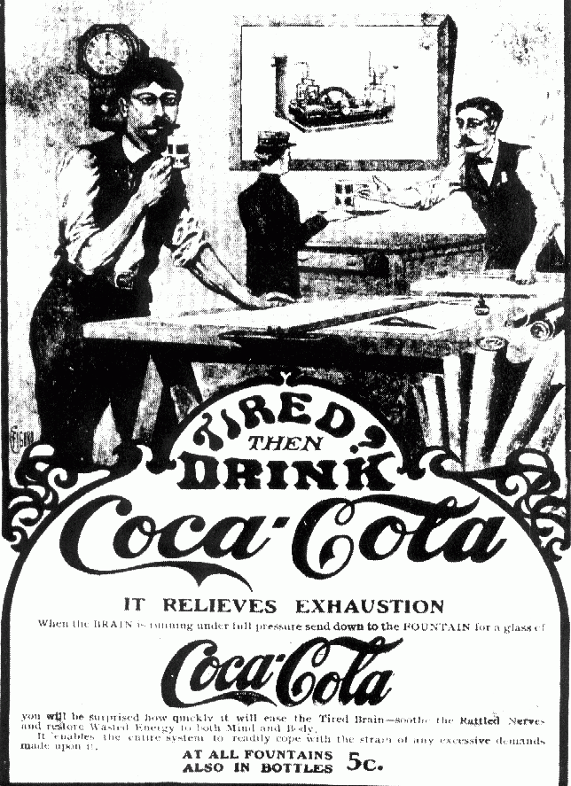
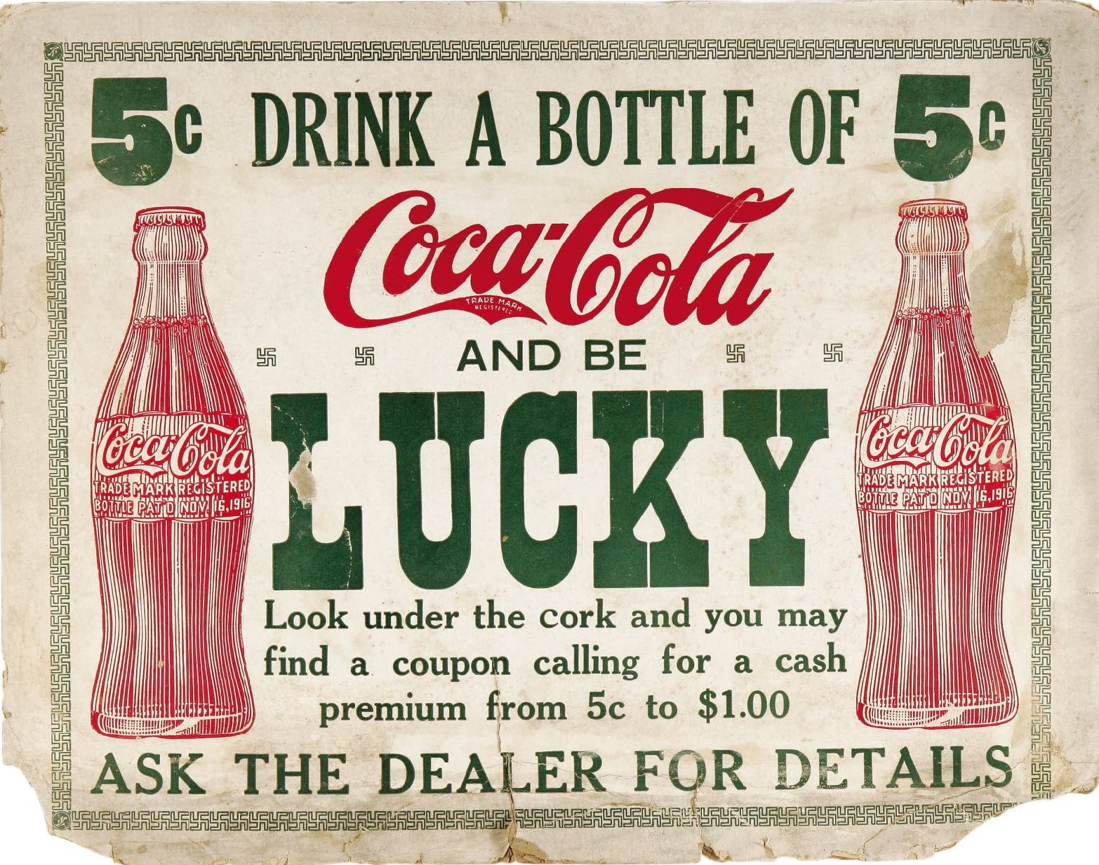
II. PsychoActive Drugs
1. Stimulants
Cocaine
• self-confidence, euphoria, optimism
• Crack - fast-acting, potent
• High risk for physical & psych dependence
Notes:
Cocaine: The recipe for Coca-Cola originally included an extract of the coca plant, creating a cocaine tonic for tired elderly people. Between 1896 and 1905, Coke not only included cocaine, but advertised the ingredient. But no longer. Cocaine is now snorted, injected, or smoked. It enters the bloodstream quickly, producing a rush of euphoria that depletes the brain’s supply of the neurotransmitters dopamine, serotonin, and norepinephrine. Within the hour, a crash of agitated depression follows as the drug’s effect wears off. Many regular cocaine users chasing this high become addicted.
Experiments have shown that cocaine addicted monkeys have pressed levers more than 12,000 times to gain one cocaine injection.
In situations that trigger aggression, ingesting cocaine may heighten reactions.
Experiment: Caged rats fight when given foot shocks, and they fight even more when given cocaine and foot shocks. Likewise, humans ingesting high doses of cocaine in laboratory experiments impose higher shock levels on a presumed opponent than do those receiving a placebo.
Cocaine use may also lead to emotional disturbances, suspiciousness, convulsions, cardiac arrest, or respiratory failure.
In national 1991 surveys, 3 percent of U.S. high school seniors and 6 percent of British 18- to 24-year-olds reported having tried cocaine during the past year. Nearly half had smoked crack. Crack is a faster-working crystallized form of cocaine that produces a briefer but more intense high, followed by a more intense crash. After several hours, the craving for more wanes, only to return several days later.
Cocaine’s psychological effects depend in part on the dosage and form consumed, but the situation and the user’s expectations and personality also play a role. Given a placebo, cocaine users who thought they were taking cocaine often had a cocaine-like experience.

Slide 6
II. PsychoActive Drugs
Before: 1998 After: 2002
1. Stimulants
Methamphetamine
Crystal-like powered, usually rock-like solid chucks
- elated, rush, confidence
- up to 8 hrs, creates long binges
- depression, insomnia
Woman’s meth addiction led to physical changes. These two photos, taken at age 36 and, after four years of addiction, at age 40.
Notes:
Methamphetamine: Methamphetamine is chemically related to its parent drug, amphetamine, but has even greater effects. Amphetamines are sometimes prescribed by physicians to reduce appetite or fatigue, and they’re also prescribed as treatment for attention-deficit/hyperactivity disorder (ADHD).
Methamphetamine triggers the release of the neurotransmitter dopamine, which stimulates brain cells that enhance energy and mood, leading to eight hours or so of heightened energy and euphoria. Its aftereffects may include irritability, insomnia, hypertension, seizures, social isolation, depression, and occasional violent outbursts. Over time, methamphetamine may reduce baseline dopamine levels, leaving the user with depressed functioning.

Slide 7
II. PsychoActive Drugs
1. Stimulants
Ecstacy (MDMA)
Both stimulant + hallucinogen
- extends serotonin feeling
- high energy & emotion- intimacy/passion
- damages serotonin production - thus depression
MDMA - Club Drug - Hug Drug
Notes:
Ecstasy: Ecstasy, a street name for MDMA (methylenedioxymethamphetamine), is both a stimulant and a mild hallucinogen. As an amphetamine derivative, Ecstasy triggers dopamine release, but its major effect is releasing stored serotonin and blocking its reuptake, thus prolonging serotonin’s feel-good flood. Users feel the effect about a half-hour after taking an Ecstasy pill. For three or four hours, they experience high energy, emotional elevation, and (given a social context) connectedness with those around them (“I love everyone”).
MDMA In the 1970s and 80s, MDMA was sometimes used in couple's therapy to boost empathy and improve emotional communication skills. It was said to be very successful in speeding up the effects of therapy. In1985, the U.S. Drug Enforcement Administration (DEA) banned the drug. During the 1990s, Ecstasy’s popularity soared as a “club drug” taken at night- clubs and all-night raves.
Short term Effect: One is its dehydrating effect, which—when combined with prolonged dancing—can lead to severe overheating, increased blood pressure, and death.
Long-term Effect: repeated leaching of brain serotonin can damage serotonin-producing neurons, leading to decreased output and increased risk of permanently depressed mood. Ecstasy also suppresses the disease-fighting immune system, impairs memory, slows thought, and disrupts sleep by interfering with serotonin’s control of the circadian clock.

